Slide 1
Berwick-Montuna Golf Club Partnership

Slide 2
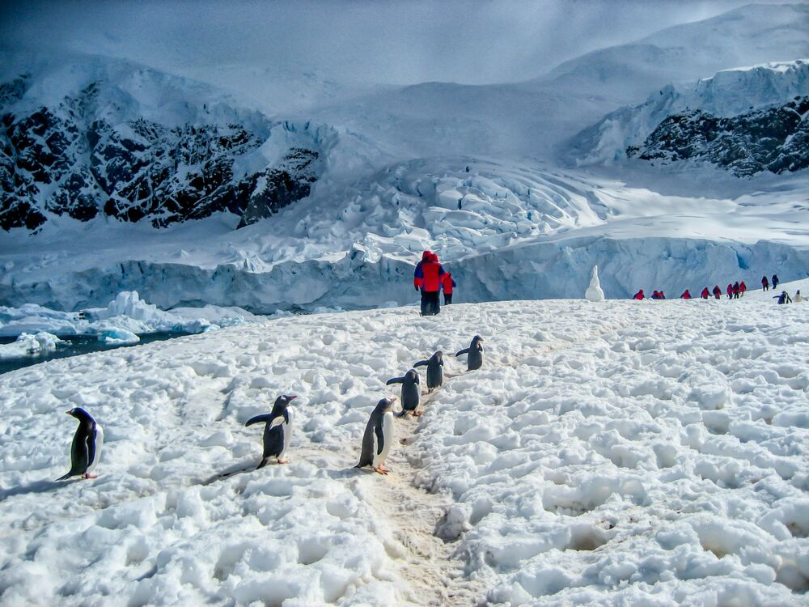
Bucket List And Sports Travel EXPERIENCES
BLAST EXPERIENCES | 2019

Slide 3
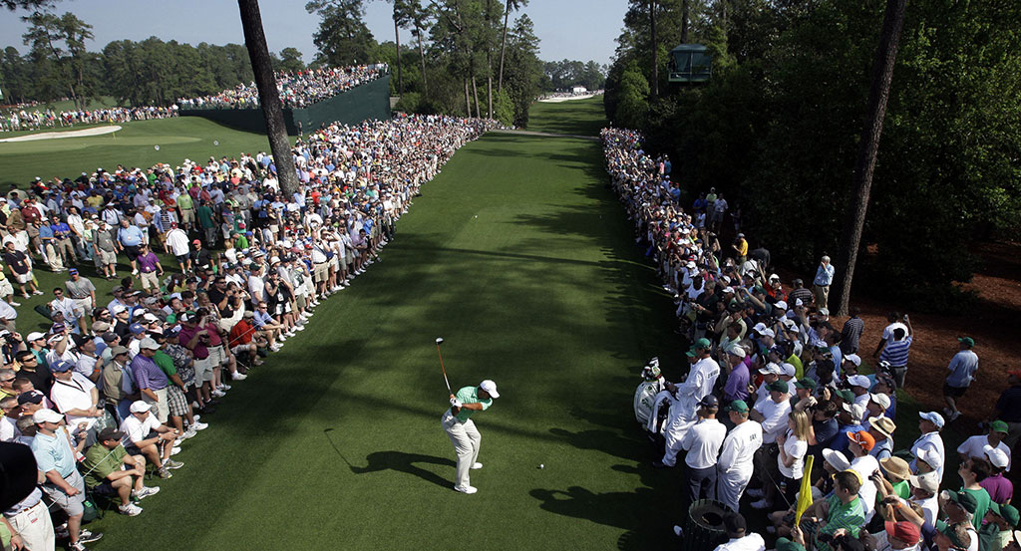
BRINGING YOUR TRAVEL DREAMS TO REALITY
CREATING LIFE LONG STORIES AND MEMORIES
BLAST EXPERIENCES | 2019

Slide 4
CALLUM BROWN
Director
ROY DASS
Director
Over 55 years Travel Industry experience
Australian owned and based
Debt free
Growing business
BLAST EXPERIENCES | 2019

Slide 5
OUR SPECIALTY
We are not a travel agent! We are your Travel Broker
We have access to Global buying power (Product & Pricing) & not restricted to supplier contracts
Sport related travel, both spectator, participant or combined
Group Travel (Sport / Schools / Business / Friends)
Tailor make your itinerary based on your vision
Convenient, Flexible & Mobile
Hosting service available
Experienced consultants only – never liaise with a novice.
Committed to relationships

Slide 6
DID YOU KNOW…
We offer 9 Months Interest Free
Accept Flight Centre Gift Cards
Can redeem your CBA rewards points towards your holiday
Have access to World Travel Expo exclusive deals in October and February – ask for more details
BLAST Experiences has access to the worlds true bucket list sporting events – check out our website and sporting calendar
www.blastexperiences.com.au/sports-calendar
Tennis Australian Open 2020 and Cricket T20 World Cup
SELLING FAST

Slide 7
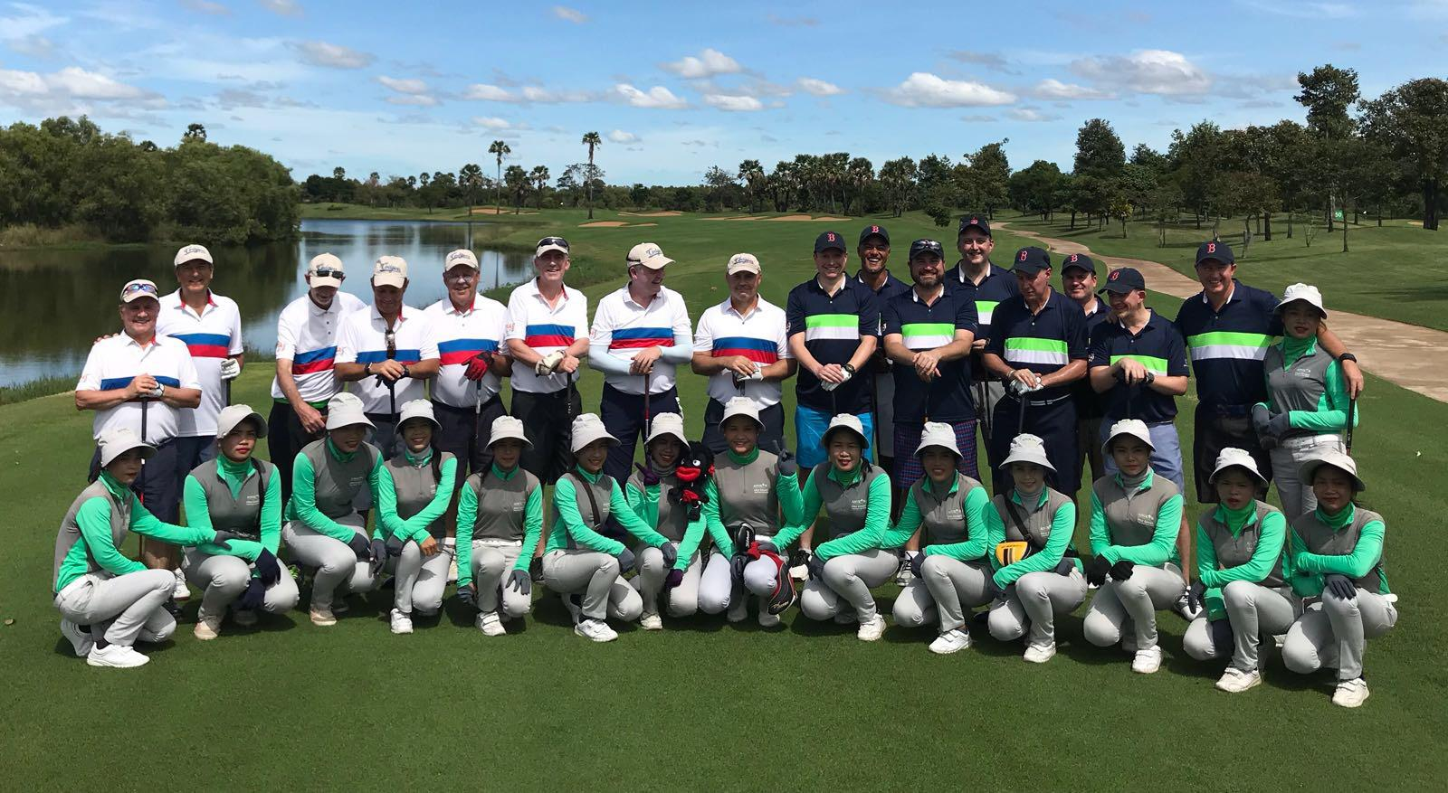
BLAST HOSTED TOUR
GOLF – HUA HIN – THAILAND
Return economy non stop airfares flying Thai Airways including taxes
3 rounds of golf at Black Mountain, Banyan & Springfield including Cart & Caddie
5 nights' accommodation at Anantara Hua Hin Resort & Spa including daily breakfast
All airport, land, and golf course private transfers
Daily drinking water
24/7 golf hotline staffed by knowledgeable service personnel
Local knowledge, expertise, suggestions, and support throughout the trip
All taxes and compulsory service charges
Costs pp from $2,399 or Non Golfer $1699 Twin Share - Based on min of 4 Golfers
*cost is non hosted

Slide 8
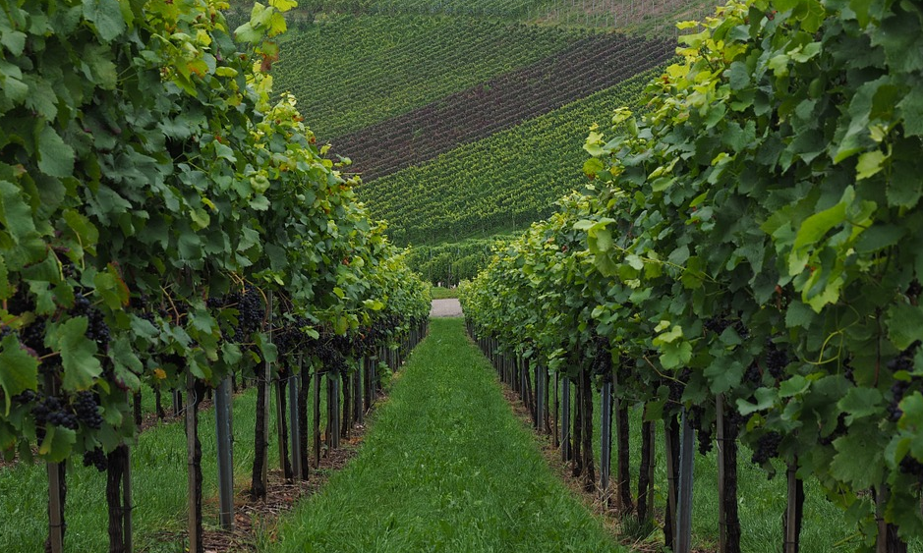
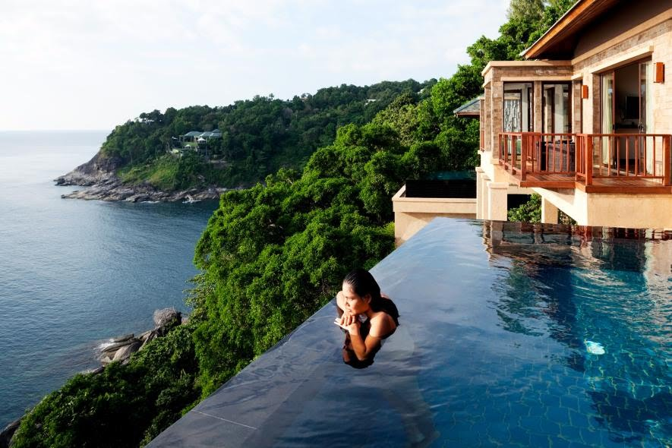
CELEBRATING A MILESTONE?
From cruising around the Croatian Islands on a private charter boat with your best friends
To booking out a luxurious villa with chef, butler and maid’s on hand to enhance the festivities
To a weekend sipping wine in the Hunter Valley and everything in between
Whatever the Experience you are after, we are here to make it a reality

Slide 9
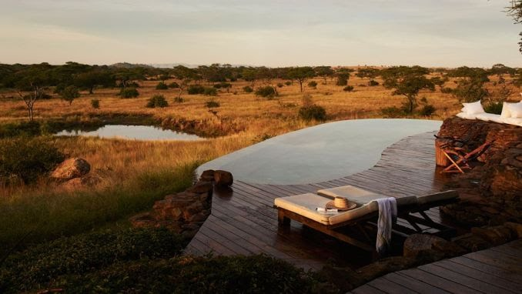
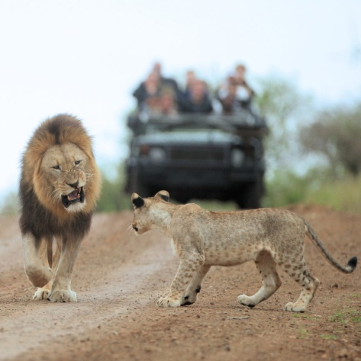
15 DAY TIMELESS AFRICAN SAFARI & LUXURY ROVOS RAIL
iNCLUDES
Return international airfares with South African Airways
All internal Africa airfares
All airport transfers and station transfers
10 nights premium hotel and lodge accommodation
2 nights onboard ultra-luxury Rovos Rail
Daily breakfast, 4 lunches and 7 dinners
Incredible sightseeing and game drives
From $7,199 per person twin share

Slide 10
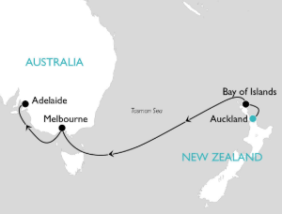
11 NIGHT CUNARD LUXURY NEW ZEALAND & AUSTRALIA FLY-STAY-CRUISE
INCLUDES
Return economy airfare to Auckland returning from Adelaide
7 Night cruise from Auckland to Adelaide onboard Cunard Queen Elizabeth in an Interior Stateroom (Cabin Upgrades available)
All onboard meals in complimentary dining venues and selected non-alcoholic beverages
Wide range of onboard activities and entertainment
All port taxes and charges included
2 Night pre-cruise premium accommodation in Auckland
Full day Taste of Waiheke tour including guided tour of 3
wineries, wine tasting and lunch at Stonyridge
2 Night post-cruise premium accommodation in Adelaide
Full day Barossa food and wine experience including morning
tea and wine tasting at Pindarri Estates, visit Maggie Beer’s
farm shop and 2-course lunch with wine tasting at Lambert Estate
Total cost per person is $2,990
Sail Date 21st Jan 2020

Slide 11
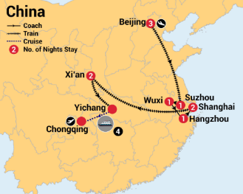
16 DAY BEST OF CHINA & YANGTZE CRUISE
iNCLUDES
Return international airfares with China Southern
Return airport transfers in-destination
10 nights in world-recognised hotels brands
4 nights on a majestic Yangtze River cruise in a balcony cabin
Daily breakfast, 8 lunches and 3 dinners
Escorted by an English-speaking guide throughout
Incredible sightseeing as per the itinerary
Dedicated private transportation throughout
From $2,599 per person twin share

Slide 12
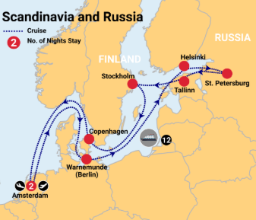
16 DAY SCANDINAVIA & RUSSIA CRUISE
iNCLUDES
Return international airfares with Emirates
12 night Scandinavia & Russia cruise on board Celebrity Reflection, including all meals, entertainment and onboard gratuities
2 nights in centrally located 4-star accommodation in Amsterdam before your cruise
Breakfast daily
Includes all cruise taxes and port & handling
charges
Departures up until September 2020
From $4,999 per person twin share

Slide 13
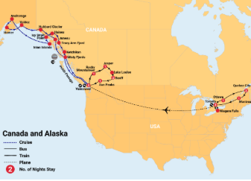
33 DAY INCREDIBLE CANADA & ALASKA WITH ROCKY MOUNTAINEER
iNCLUDES
Return international airfares with Air Canada
Return airport transfers and airport meet & greet
2 days onboard the Rocky Mountaineer in a SilverLeaf carriage including all meals, drinks and snacks on board
Internal flight from Toronto to Vancouver with Air Canada
Escorted English speaking guide throughout Eastern Canada and the Rockies
16 nights 3 to 4-star accommodation including porterage
14 night in-depth Alaska cruise on board Holland America’s intimate MS Maasdam
Daily breakfast, 16 lunches, 14 dinners
Incredible sightseeing as per the itinerary
BONUS Specialty dining package on board your cruise
including lunch at Pinnacle Grill, Dinner at Canaletto,
sparkling wine and more
From $11,999 per person twin share

Slide 14
PARTNERSHIP
Your Clubs official travel partner
Contribution of travel spend back to club
20% off Travel Insurance all members and affiliates
CONTACT BERWICK-MONTUNA GOLF CLUB
DEDICATED TRAVEL ASSOCIATE
Jen Muzyk
0413 821 538
jen@blastexperiences.com.au
Callum Brown - Director
0408 950 889
callum@blastexperiences.com.au
BLAST EXPERIENCES | 2019

